Slide 1
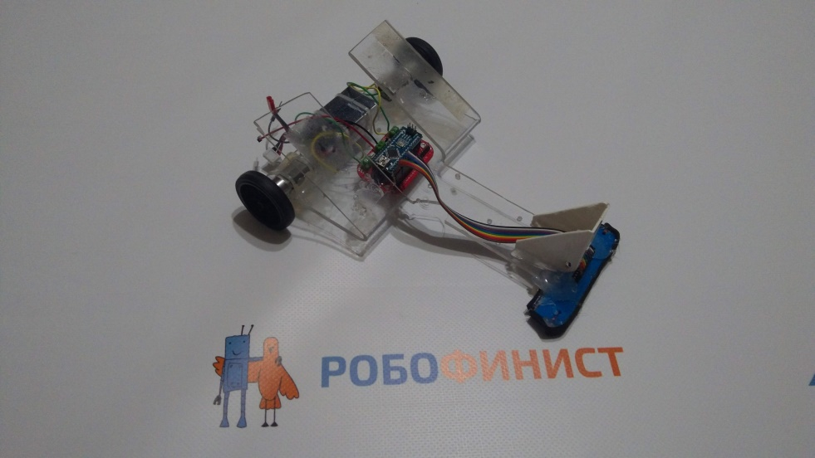
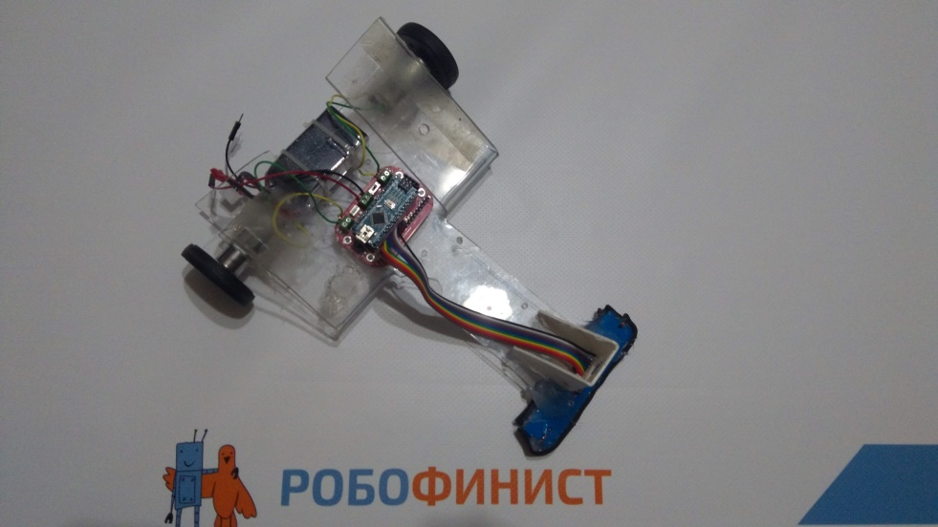
NARROW LİNE FOLLOWER
BİLROTEK TEAM
Participant: Kaan AYYILDIZ
Supervisor: Adem AKKUŞ

Slide 2
Component List:
-Pololu QTR-8A Reflectance Sensor (8 Pieces Reflectance Sensor)
-L298 Motor Driver Card
-Arduino Nano
-dc12V 2000RPM gear motor
-2000mA 11.7V Li-po battery
-3D Design chasis
-10mm wide 30mm diameter rubber tire
-IR Reciever for starting

Slide 3
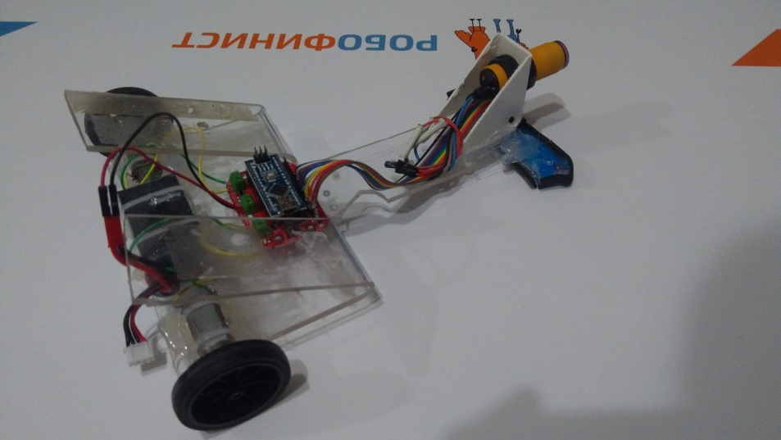
Description
Robot starts when recieves IR signal from remote control . It follows the blcak line on the white surface with information from qtr8 using PID method. We added mz80 infrared sensor for any surprise task.

