Slide 1
CRO-ADRIATIC
ANTONIO NIKOLIĆ AND PAŠKO ZEKIĆ

Slide 2
About team
CroAdriatic is a team of young roboticians who are competing in competitions RoboCup
These are the members of the team:
  Antonio Nikolić,
  Paško Zekić and
  Zoran Vukić
CroAdriatic actively participates in Robocup competitions. In 2016 the team has achieved excellent results at the RoboCup Soccer Lightweight Primary
They won 1st place at the International competitions in Innsbruck and Wein and 2nd place at the World competition in Leipzing

Slide 3
TEAM MEMBERS:
Antonio Nikolić is the captain of the CroAdriatic team. He is also member of the Croatian association of the young robotics. He has been working with robots for three years now. He is diligent and hard working young man fully task oriented and persistent in achiving goals and finding solutions.
He has been to many competitions:
RoboCup Leizig 2016.
RoboCup Innsbruck 2016.
RoboCup Weiz 2017.
Paško Zekić is the member of the CroAdriatic team. His role in a team is to develop the construction of the robot. He is an excelent team worker full of ideas always ready to work for hours.
So far he was at the competition RoboCup Weiz 2017
Zoran Vukić is the mentor of the CroaAdriatic team.
He works as a teacher in the primary school „Knez Trpimir“. Besides his regular job he has been teaching robotics as extracuriculum subject for 15 years now. He is passionate in promoting robotics but also helping young people use their free time in a good way. For his work he was rewarded with „Faust Vrančić“ eward , one of the higest rewards in Croatian school system.

Slide 4
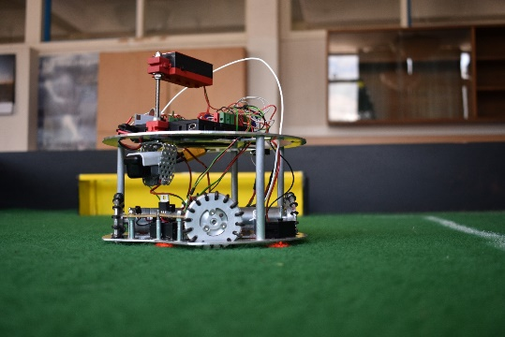
THE DESRIPTION OF THE ROBOT
We have made robots using our own ideas, designs and prototypes
There are three versions of the robots:
  The first version- brought us first place at the International competition in Insbruck
  The second version- was made for the World competition and got us 2nd place. The original robot has been improved by the fourth electric motor.
  The third version was made of aluminium
Program
Program was made in RoboPro
It contains 25 subprograms
Construction
Robot is made of aluminium.
The brackets of the second level of the robots are made from aircraft
grade aluminium to minimize the weight of the robot
Construction is cut on CNC mill.
Drawings were made by members of the team in programs CorelDraw
and AutoCAD

Slide 5
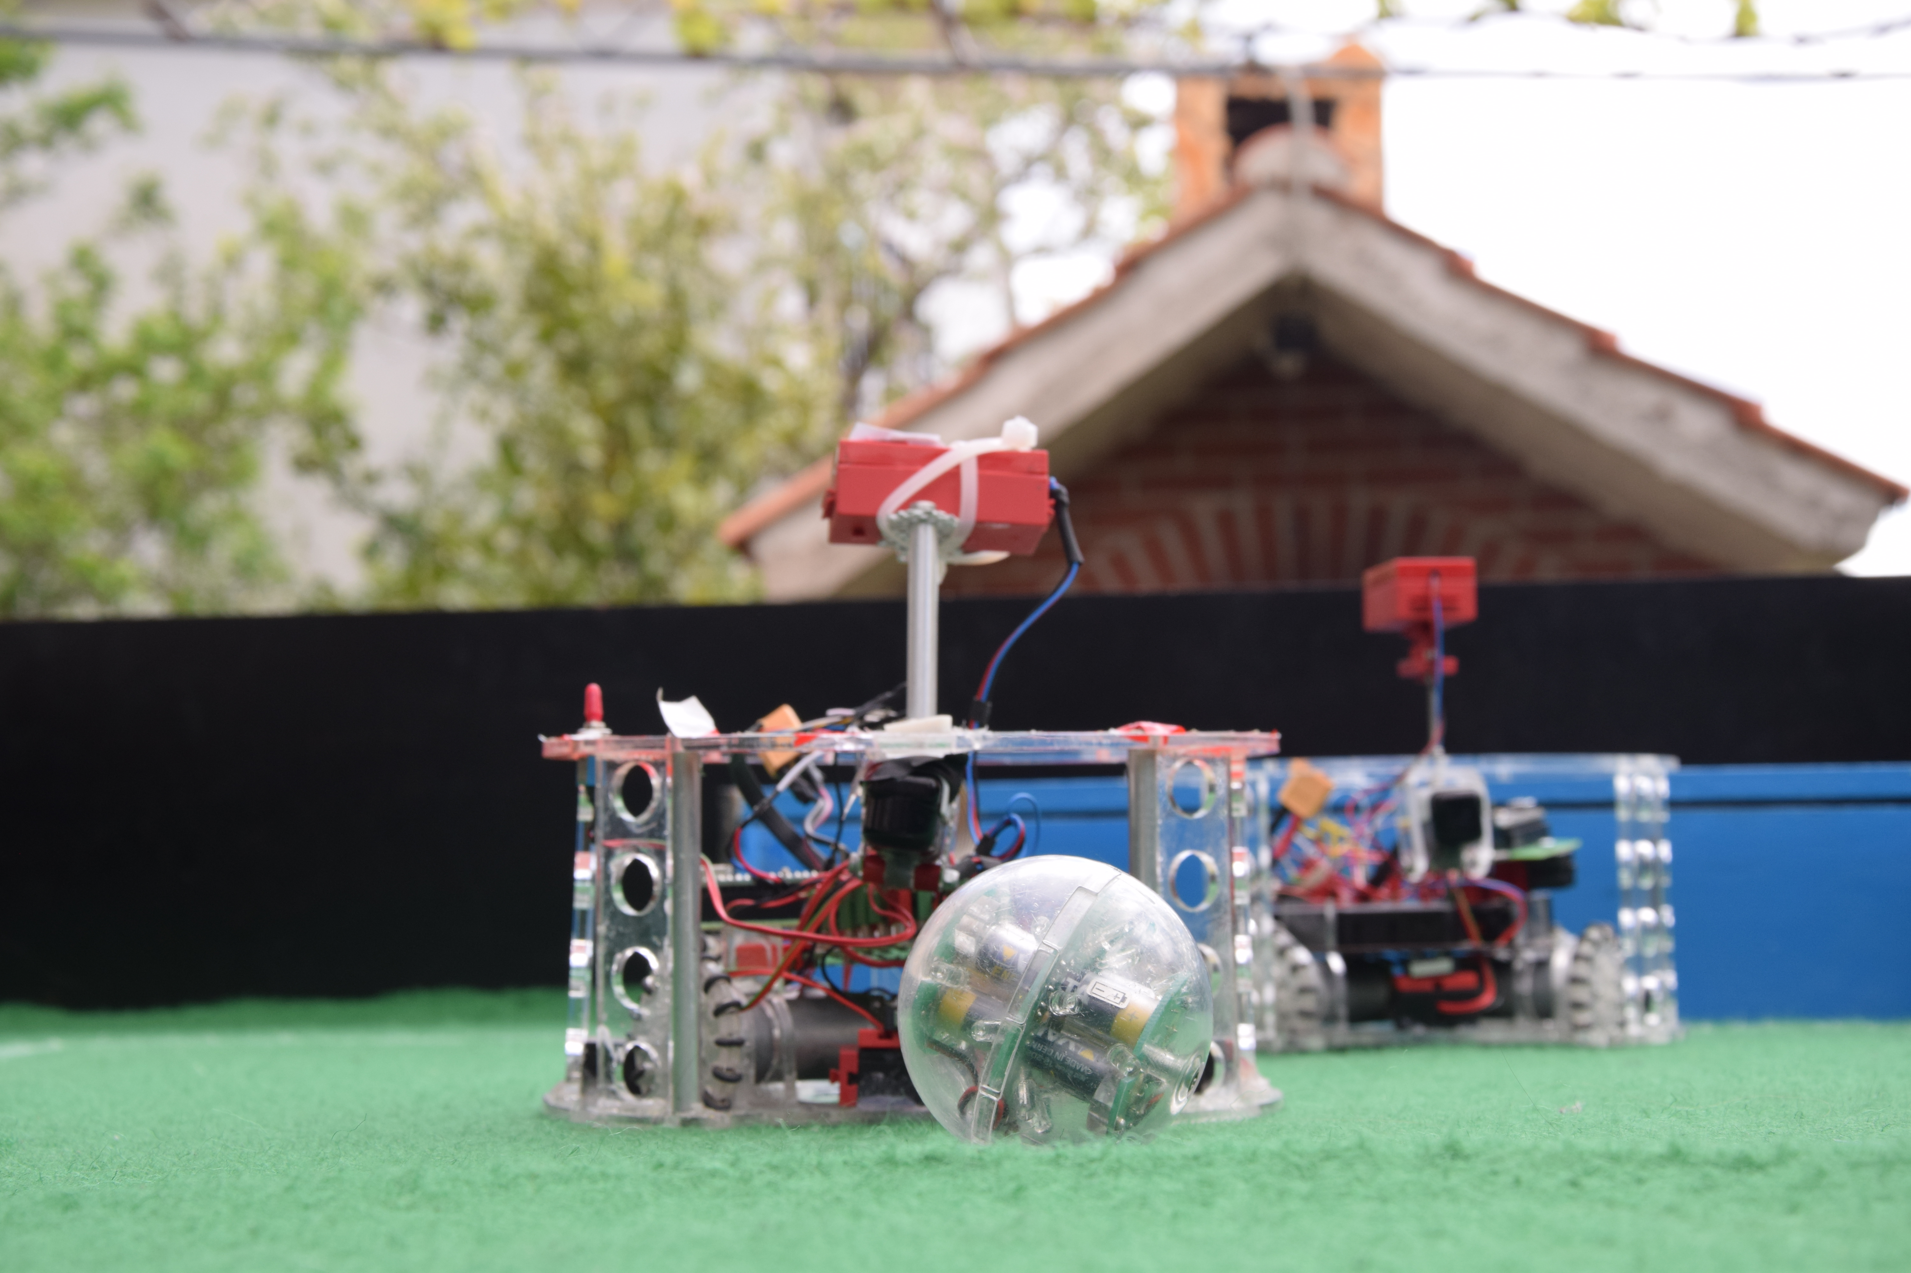
THIS IS OLD ROBOT VERSION 2.0

